Slide 1
Introduction to R
Abhijit Dutt

Slide 2
History of R
S: language for data analysis developed at Bell Labs circa 1976
Licensed by AT&T/Lucent to Insightful Corp. Product name: S-plus.
R: initially written & released as an open source software by Ross Ihaka and Robert Gentleman at U Auckland during 90s (R plays on name “S”, as S was not open source)
Since 1997: international R-core team ~15 people & 1000s of code writers and statisticians happy to share their libraries!

Slide 3
“Open source”... that just means I don’t have to pay for it, right?
No. Much more:
Provides full access to algorithms and their implementation
Gives you the ability to fix bugs and extend software
Provides a forum allowing researchers to explore and expand the methods used to analyze data
Is the product of 1000s of leading experts in the fields they know best. It is CUTTING EDGE.
Ensures that scientists around the world - and not just ones in rich countries - are the co-owners to the software tools needed to carry out research
Promotes reproducible research by providing open and accessible tools
Most of R is written in… R! This makes it quite easy to see what functions are actually doing.
5

Slide 4
What is it?
www.r-project.org
R is an interpreted computer language.
Most user-visible functions are written in R itself, calling upon a smaller set of internal primitives.
It is possible to interface procedures written in C, C+, or FORTRAN languages for efficiency, and to write additional primitives.
System commands can be called from within R

Slide 5
What is it?
R is used for data manipulation, statistics, and graphics. It is made up of:
operators (+ - <- * %*% …) for calculations on arrays & matrices
large, coherent, integrated collection of functions
facilities for making unlimited types of publication quality graphics
user written functions & sets of functions (packages); 800+ contributed packages so far & growing

Slide 6
R Data Types
Numeric
Integer
Character
Dates
Logical

Slide 7
R Data Structure
Vector (Collection of elements all of the same type)
Factor (Vector used with character)
Data Frame (It consists of columns that have exactly same length; however each column could be of different data types)
A data frame has rows and columns – we can say each row is an observation and each column is a variable.
Matrix – a data frame where all elements are of same data type
Arrays – A multidimensional vector

Slide 8

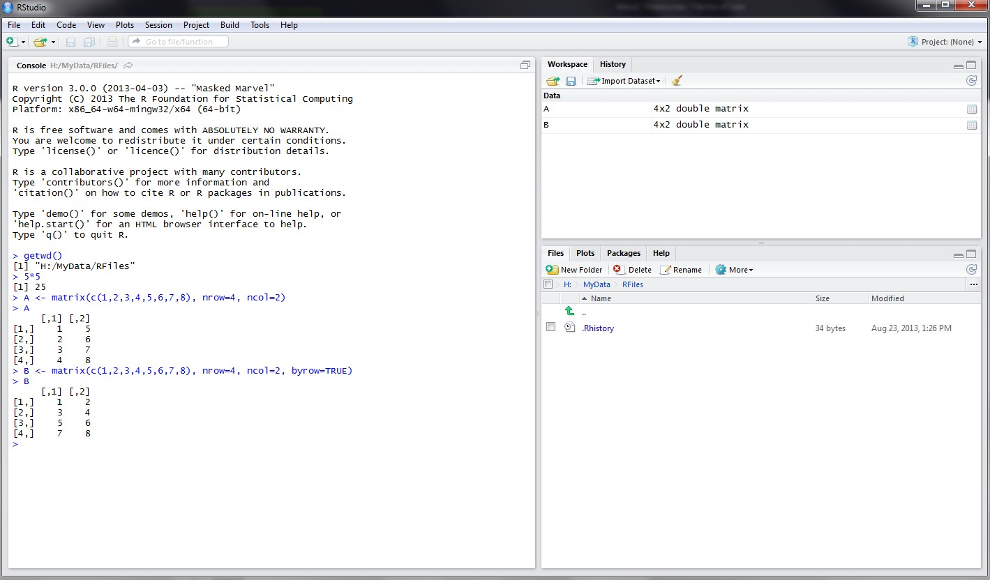
RStudio screen
The workspace tab shows all the active objects (see next slide). The history tab shows a list of commands used so far.
The files tab shows all the files and folders in your default workspace as if you were on a PC/Mac window. The plots tab will show all your graphs. The packages tab will list a series of packages or add-ons needed to run certain processes. For additional info see the help tab
The console is where you can type
commands and see output

Slide 9
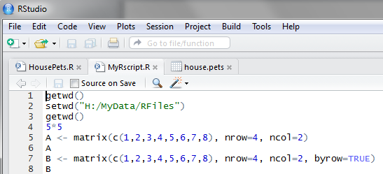
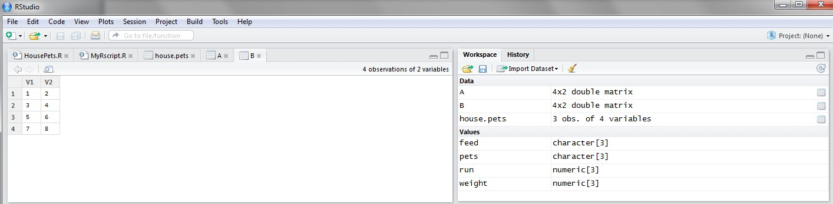
Workspace tab (1)
The workspace tab stores any object, value, function or anything you create during your R session. In the example below, if you click on the dotted squares you can see the data on a screen to the left.
Showing here matrix B. To see matrix A click on the respective tab.

Slide 10
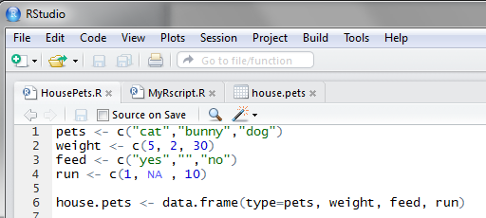
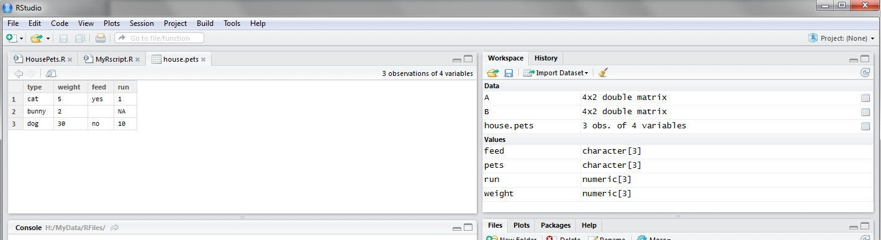
Workspace tab (2)
Here is another example on how the workspace looks like when more objects are added. Notice that the data frame house.pets is formed from different individual values or vectors.
Click on the dotted square to look at the
dataset in a spreadsheet form.

Slide 11
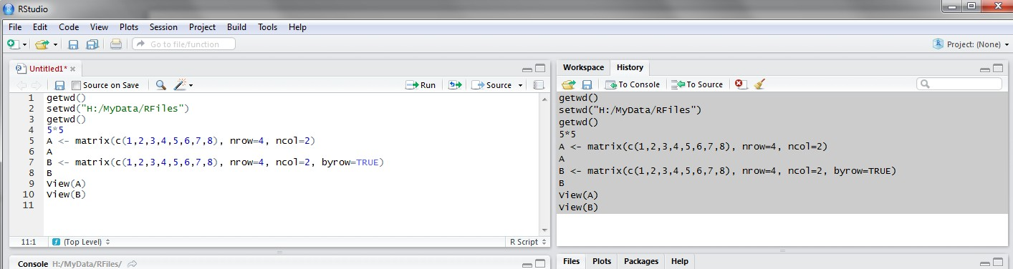
History tab
The history tab keeps a record of all previous commands. It helps when testing and running processes. Here you can either save the whole list or you can select the commands you want and send them to an R script to keep track of your work.
In this example, we select all and click on the “To Source” icon, a window on the left will open with the list of commands. Make sure to save the ‘untitled1’ file as an *.R script.

Slide 12
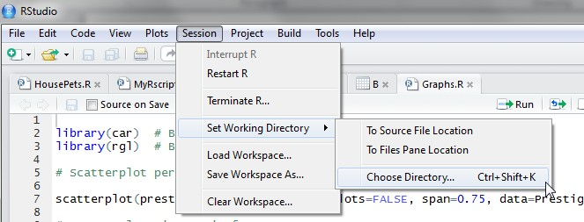
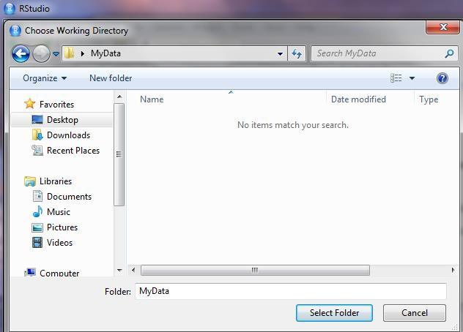
Changing the working directory
1
2
If you have different projects you can change the working directory for that session, see above. Or you can type:
# Shows the working directory (wd)
getwd()
# Changes the wd
setwd("C:/myfolder/data")
More info see the following document: http://dss.princeton.edu/training/RStata.pdf
3

Slide 13
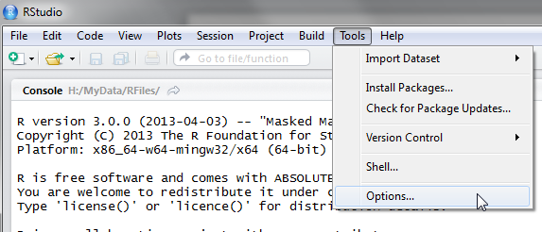
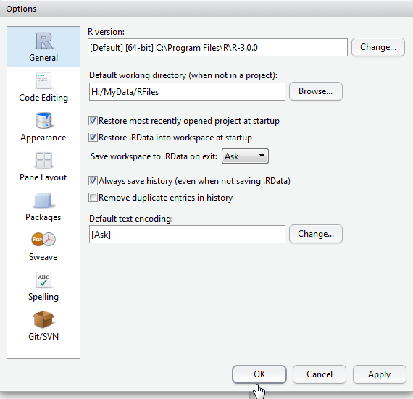
Setting a default working directory
1
2
3
Every time you open RStudio, it goes to a default directory. You can change the default to a folder where you have your datafiles so you do not have to do it every time. In the menu go to Tools->Options
4

Slide 14
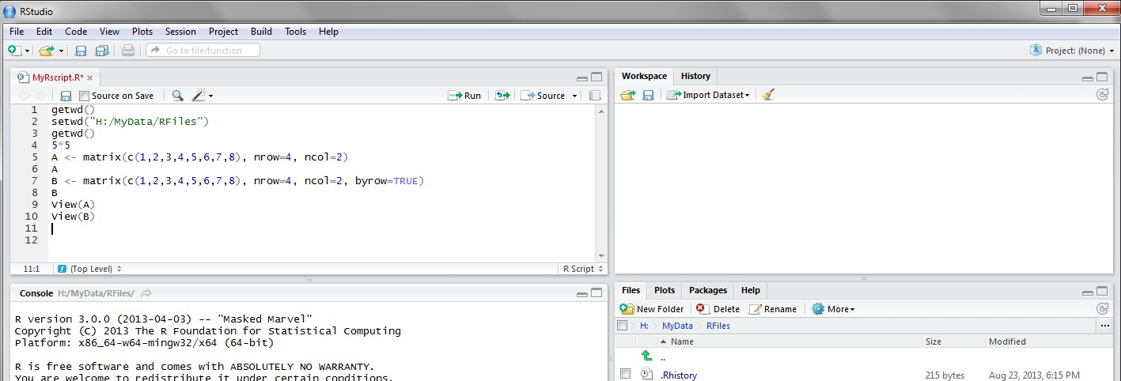
R script (1)
The usual Rstudio screen has four windows:
Console.
Workspace and history.
Files, plots, packages and help.
The R script(s) and data view.
The R script is where you keep a record of your work. For Stata users this would be like the do-file, for SPSS users is like the syntax and for SAS users the SAS program.

Slide 15
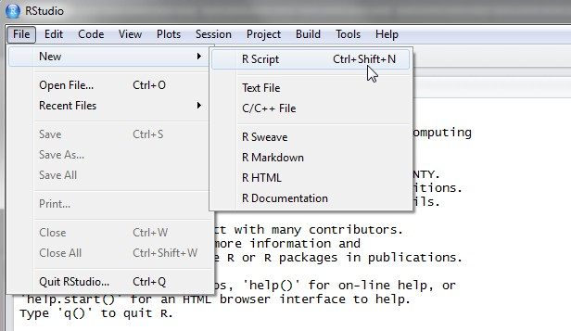
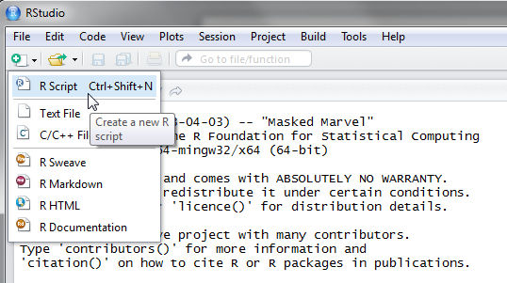
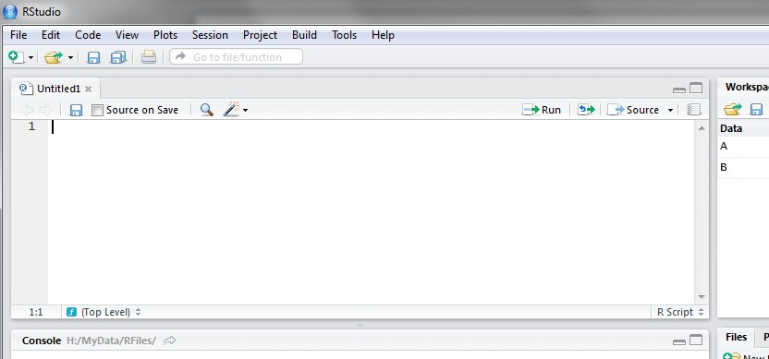
R script (2)
To create a new R script you can either go to File -> New -> R Script, or click on the icon with the “+” sign and select “R Script”, or simply press Ctrl+Shift+N. Make sure to save the script.
Here you can type R commands and run them. Just leave the cursor anywhere on the line where the command is and press Ctrl-R or click on the ‘Run’ icon above. Output will appear in the console below.

Slide 16
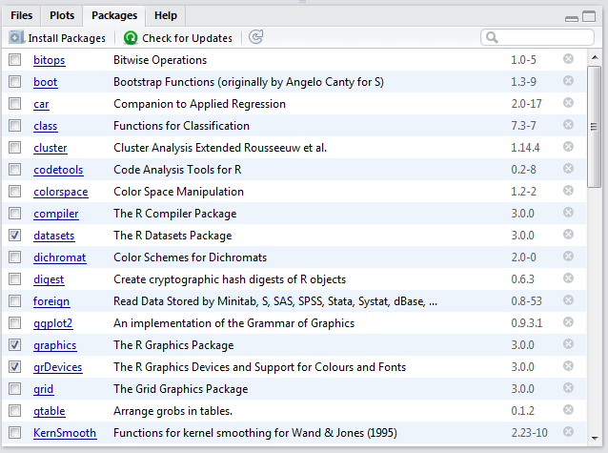
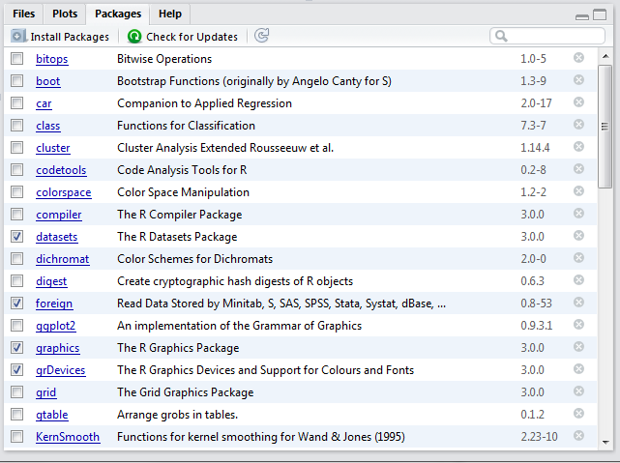
Packages tab
The package tab shows the list of add-ons included in the installation of RStudio. If checked, the package is loaded into R, if not, any command related to that package won’t work, you will need select it. You can also install other add-ons by clicking on the ‘Install Packages’ icon. Another way to activate a package is by typing, for example, library(foreign). This will automatically check the --foreign package (it helps bring data from proprietary formats like Stata, SAS or SPSS).

Slide 17
Interactive R
R defaults to an interactive mode
A prompt “>” is presented to users
Each input expression is evaluated…
… and a result returned

Slide 18
R as a Calculator
1 + 1 [1] 2 | # | Simple Arithmetic
2 + 3 * 4 [1] 14 | # | Operator precedence
3 ^ 2 | # | Exponentiation
[1] 9 exp(1) | # | Basic mathematical functions are available
[1] 2.718282 sqrt(10)
[1] 3.162278 pi | # | The constant pi is predefined
[1] 3.141593 2*pi*6378 | # | Circumference of earth at equator (in km)
[1] 40074.16

Slide 19
Variables in R
Numeric
Store floating point values
Boolean (T or F)
Values corresponding to True or False
Strings
Sequences of characters
Type determined automatically when variable is created with "<-" operator

Slide 20
R as a Smart Calculator
x y | <- 1 <- 3 | # # | Can define variables using "<-" operator to set values
z | <- 4
x | * y * z
[1] X | 12 * Y * Z | # | Variable names are case sensitive
Error: Object "X" not found
This.Year <- 2004
This.Year
[1] 2004
# Variable names can include period

Slide 21
R does a lot more!
Definitely not just a calculator
R thrives on vectors
R has many built-in statistical and graphing functions

Slide 22
R Vectors
A series of numbers
Created with
c() to concatenate elements or sub-vectors
rep() to repeat elements or patterns
seq() or m:n to generate sequences
Most mathematical functions and operators can be applied to vectors
Without loops!

Slide 23
Defining Vectors
rep(1,10) [1] 1 1 1 1 | 1 | 1 | 1 | # repeats the number 1, 10 times 1 1 1
seq(2,6) [1] 2 3 4 5 | 6 |  |  | # sequence of integers between 2 and 6 # equivalent to 2:6
seq(4,20,by=4)
[1] 4 8 12 16 20
x <- c(2,0,0,4)
y <- c(1,9,9,9)
x + y
[1] 3 9 9 13
x * 4
[1] 8 0 0 16
# Every 4th integer between 4 and 20
# Creates vector with elements 2,0,0,4
# Sums elements of two vectors
# Multiplies elements
sqrt(x) # Function applies to each element
[1] 1.41 0.00 0.00 2.00 # Returns vector

Slide 24
Accessing Vector Elements
Use the [] operator to select elements
To select specific elements:
Use index or vector of indexes to identify them
To exclude specific elements:
Negate index or vector of indexes
Alternative:
Use vector of T and F values to select subset of elements

Slide 25
Accessing Vector Elements
x <- c(2,0,0,4)
x[1]
[1] 2
x[-1] [1] 0 0 4
# Select the first element, equivalent to x[c(1)]
# Exclude the first element
x[1] <- 3 ; x
[1] 3 0 0 4
x[-1] = 5 ; x
[1] 3 5 5 5
y < 9 # Compares each element, returns result as vector
[1] TRUE FALSE FALSE FALSE
y[4] = 1
y < 9
[1] TRUE FALSE | FALSE | TRUE
y[y<9] = 2 # | Edits | elements marked as TRUE in index vector
y
[1] 2 9 9 2

Slide 26
Data Frames
Group a collection of related vectors
Most of the time, when data is loaded, it will be organized in a data frame
Let’s look at an example …

Slide 27
Setting Up Data Sets
Load from a text file using read.table()
Parameters header, sep, and na.strings control useful options
read.csv() and read.delim() have useful defaults
for comma or tab delimited files
Create from scratch using data.frame()
Example:
data.frame(height=c(150,160),
weight=(65,72))

Slide 28
Blood Pressure Data Set
HEIGHT | WEIGHT | WAIST | HIP | BPSYS | BPDIA
172 | 72 | 87 | 94 | 127.5 | 80
166 | 91 | 109 | 107 | 172.5 | 100
174 | 80 | 95 | 101 | 123 | 64
176 | 79 | 93 | 100 | 117 | 76
166 | 55 | 70 | 94 | 100 | 60
163 | 76 | 96 | 99 | 160 | 87.5
...
Read into R using:
bp <-
read.table(“bp.txt”,header=T,na.strings=c(“x”))

Slide 29
Accessing Data Frames
Multiple ways to retrieve columns…
The following all retrieve weight data:
bp[“WEIGHT”]
bp[,2]
bp$WEIGHT
The following excludes weight data:
bp[,-2]

Slide 30
Lists
Collections of related variables
Similar to records in C
Created with list function
point <- list(x = 1, y = 1)
Access to components follows similar rules as for data frames, the following all retrieve x:
point$x; point[“x”]; point[1]; point[-2]

Slide 31
So Far …
Common Forms of Data in R
Variables are created as needed
Numeric values
Vectors
Data Frames
Lists
Used some simple functions:
c(), seq(), read.table(), …

Slide 32
Next …
More detail on the R language, with a focus on managing code execution
Grouping expressions
Controlling loops

Slide 33
Programming Constructs
Grouped Expressions
Control statements
if … else …
for loops
repeat loops
while loops
next, break statements

Slide 34
Grouped Expressions
{expr_1; expr_2; … }
Valid wherever single expression could be used
Return the result of last expression evaluated
Relatively similar to compound statements in C

Slide 35
if … else …
if (expr_1) expr_2 else expr_3
The first expression should return a single logical value
Operators && or || may be used
Conditional execution of code

Slide 36
Example: if … else …
# Standardize observation i
if (sex[i] == “male”)
{
z[i] <- (observed[i] –
males.mean) / males.sd;
}
else
{
z[i] <- (observed[i] –

Slide 37
for
for (name in expr_1) expr_2
Name is the loop variable
expr_1 is often a sequence
e.g. 1:20
e.g. seq(1, 20, by = 2)

Slide 38
Example: for
# Sample M random pairings in a set of N objects for (i in 1:M)
{
# As shown, the sample function returns a single
# element in the interval 1:N p = sample(N, 1)
q = sample(N, 1)
# Additional processing as needed… ProcessPair(p, q);
}

Slide 39
repeat
repeat expr
Continually evaluate expression
Loop must be terminated with break
statement

Slide 40
Example: repeat
# Sample with replacement from a set of N objects # until the number 615 is sampled twice
M <- matches <- 0 repeat
{
# Keep track of total connections sampled M <- M + 1
# Sample a new connection p = sample(N, 1)
# Increment matches whenever we sample 615 if (p == 615)
matches <- matches + 1;
# Stop after 2 matches if (matches == 2)
break;
}

Slide 41
while
while (expr_1) expr_2
While expr_1 is false, repeatedly evaluate expr_2
break and next statements can be used within the loop

Slide 42
Example: while
# Sample with replacement from a set of N objects # until 615 and 815 are sampled consecutively match <- false
while (match == false)
{
# sample a new element p = sample(N, 1)
# if not | 615, then goto next | iteration
if (p != | 615)
next;
# Sample another element q = sample(N, 1)
# Check if we are done if (q != 815)
match = true;
}

Slide 43
Functions in R
Easy to create your own functions in R
As tasks become complex, it is a good idea to organize code into functions that perform defined tasks
In R, it is good practice to give default values to function arguments

Slide 44
Function definitions
name <- function(arg1, arg2, …)
expression
Arguments can be assigned default values:
arg_name = expression
Return value is the last evaluated expression or can be set explicitly with return()

Slide 45
Defining Functions
square <- function(x = 10) x * x
square()
[1] 100
square(2)
[1] 4
intsum <- function(from=1, to=10)
{
sum <- 0
for (i in from:to) sum <- sum + i
sum
}
intsum(3) | # Evaluates sum | from 3 to 10 …
[1] 52
intsum(to = 3) | # Evaluates sum | from 1 to 3 …
[1] 6

Slide 46
Some notes on functions …
You can print the arguments for a function using args()
command
args(intsum)
function (from = 1, to = 10)
You can print the contents of a function by typing only its name, without the ()
You can edit a function using
my.func <- edit(my.old.func)

Slide 47
Debugging Functions
Toggle debugging for a function with
debug()/undebug() command
With debugging enabled, R steps through
function line by line
Use print() to inspect variables along the way
Press <enter> to proceed to next line
debug(intsum)
intsum(10)

Slide 48
So far …
Different types of variables
Numbers, Vectors, Data Frames, Lists
Control program execution
Grouping expressions with {}
Controlling loop execution
Create functions and edit functions
Set argument names
Set default argument values

Slide 49
Useful R Functions
Online Help
Random Generation
Input / Output
Data Summaries
Exiting R

Slide 50
Random Generation in R
In contrast to many C implementations, R generates pretty good random numbers
set.seed(seed)can be used to select a specific sequence of random numbers
sample(x, size, replace = FALSE)
generates a sample of size elements from x.
If x is a single number, sample is from 1:x

Slide 51
Random Generation
runif(n, min = 0, max = 1)
Samples from Uniform distribution
rbinom(n, size, prob)
Samples from Binomial distribution
rnorm(n, mean = 0, sd = 1)
Samples from Normal distribution
rexp(n, rate = 1)
Samples from Exponential distribution
rt(n, df)
Samples from T-distribution
And others!

Slide 52
R Help System
R has a built-in help system with useful information and examples
help() provides general help
help(plot) will explain the plot function
help.search(“histogram”) will search for topics that include the word histogram
example(plot) will provide examples for the plot function

Slide 53
Input / Output
Use sink(file) to redirect output to a file
Use sink() to restore screen output
Use print() or cat() to generate output inside functions
Use source(file) to read input from a file

Slide 54
Basic Utility Functions
length() returns the number of elements
mean() returns the sample mean
median() returns the sample mean
range() returns the largest and smallest values
unique() removes duplicate elements
summary() calculates descriptive statistics
diff() takes difference between consecutive elements
rev() reverses elements

Slide 55
Managing Workspaces
As you generate functions and variables, these are added to your current workspace
Use ls() to list workspace contents and rm()
to delete variables or functions
When you quit, with the q() function, you can save the current workspace for later use

Slide 56
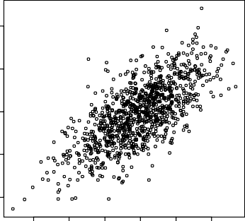
Introduction to R Graphics
200
Histogram of x
4
x <- rnorm(1000)
y <- rnorm(1000) + x
summary(y)
150
2
Frequency
100
y
0
50
-2
0
-4
-4
-3
-2
-1 0
1
2
3
-3
-2
-1 0
1
2
x
x
Min. 1st Qu. Median | Mean | 3rd Qu. | Max.
-4.54800 -1.11000 -0.06909 | -0.09652 | 0.86200 | 4.83200
var(y)
[1] 2.079305
hist(x, col="lightblue")
plot(x,y)

Slide 57
Example: Quick Find Function
QuickFind <- function( N = { | 100, | M = 100)
a <- seq(1, N) | # | initialize array
for (dummy in seq(1,M)) | # | for each connection
{ p <- sample(N, 1) | # | sample random objects
q <- sample(N, 1)
if (a[p] == a[q]) | # | check if connected
next
a[a == a[p]] <- a[q]
}
# update connectivity array
}

Slide 58
Example: Quick Union Function
QuickUnion <- function( N = 100, M = 100)
{
a <- seq(1, N) # initialize array
for (dummy in seq(1,M))
{
p <- sample(N, 1) q <- sample(N, 1)
# for each connection
# sample random objects
# check if connected
i = a[p]; while (a[i] != i) i <- a[i]
j = a[q]; while (a[j] != j) j <- a[j]
if (i == j)
next
a[i] = j
}
# update connectivity array
}

Slide 59
Example: Weighted Quick Union
WeightedQuickUnion <- function( N = 100, M = 100)
{
a <- seq(1, N) weight <- rep(1, N)
# initialize arrays
for (dummy in seq(1,M))
{
p <- sample(N, 1) q <- sample(N, 1)
# for each connection
# sample random objects
i = a[p]; while (a[i] != i) i <- a[i]
j = a[q]; while (a[j] != j) j <- a[j]
# FIND
if (i == j) next
if (weight[i] < weight[j]) # UNION
{ a[i] = j; weight[j] <- weight[j] + weight[i]; }
else
{ a[j] = i; weight[i] <- weight[i] + weight[j]; }
}
}

Slide 60
Benchmarking a function
To conduct empirical studies of a functions performance, we don’t always need a stopwatch.
Relevant functions
Sys.time() gives current time
difftime(stop, start) difference
between two times

Slide 61
Example: Slower Quick Find…
QuickFind2 <- function( N = 100, M = 100)
{
a <- seq(1, N) # initialize array
for (dummy in seq(1,M)) # for each connection
{
p <- sample(N, 1) # sample random objects q <- sample(N, 1)
if (a[p] == a[q]) # check if connected
next
set <- a[p]
for (i in 1:N)
if (a[i] == set)
a[i] = a[q]
}
# update connectivity array
}

Slide 62
Example: Slower Quick Find…
bench <- function(f, N = 100, M = 100)
{
cat(" N = ", N, ", M = ", M, "\n")
start <- Sys.time() f(N, M)
stop <- Sys.time() difftime(stop, start)
}
bench(QuickFind, 4000, 4000) N = 4000 , M = 4000
Time difference of 2 secs
bench(QuickFind2, 4000, 4000) N = 4000 , M = 4000
Time difference of 1.066667 mins

Slide 63
Summary
Unless there is a need you need not use loops
In your Assignment, use direct methods as much as possible

